Slide 1

Academic Session 2025-26
EVEN Semester Jan-Jun 2026
UNIVERSITY INSTITUTE OF Engineering
CSE 3rd Year
5th SEMESTER
Numerical Methods
(23SMH-341)
Faculty Name and ECode: Dr. Heena Sharma (E6398) Cumail-ID : heena.e6398@cumail.in
Designation: Assistant Professor

Slide 2
1
Vision of University
“To be globally recognized as a Centre of Excellence for Research, Innovation, Entrepreneurship and disseminating knowledge by providing inspirational learning to produce professional leaders for serving the society.”

Slide 3
2
Mission of University
M1 : Providing world class infrastructure, renowned academicians and ideal environment for Research, Innovation, Consultancy and Entrepreneurship relevant to the society.
M2 : Offering programs & courses in consonance with National policies for nation building and meeting global challenges.

Slide 4
3
Mission of University
M3 : Designing Curriculum to match International standards, needs of Industry, civil society and for inculcation of traits of Creative Thinking and Critical Analysis as well as Human and Ethical values.
M4 : Ensuring students delight by meeting their aspirations through blended learning, corporate mentoring, professional grooming, flexible curriculum and healthy atmosphere based on co-curricular and extra-curricular activities.

Slide 5
4
Mission of University
M5 : Creating a scientific, transparent and objective examination/evaluation system to ensure an ideal certification.
M6 : Establishing strategic relationships with leading National and International corporates and universities for academic as well as research collaborations.

Slide 6
5
Mission of University
M7: Contributing for creation of healthy, vibrant and sustainable society by involving in Institutional Social Responsibility (ISR) activities like rural development, welfare of senior citizens, women empowerment, community service, health and hygiene awareness and environmental protection.

Slide 7
6
Vision of Department
To be recognized as a leading Computer Science & Engineering department through effective teaching practices and excellence in research and innovation for creating competent professionals with ethics, values and entrepreneurial attitude to deliver service to society and to meet the current industry standards at the global level.

Slide 8
7
Mission of Department
M1 : To provide practical knowledge using state-of-the-art technological support for the experiential learning of our students.
M2 : To provide industry recommended curriculum and transparent assessment for quality learning experiences.
M3 : To create global linkages for interdisciplinary collaborative learning and research.

Slide 9
8
Program Educational Objectives (PEOs)
PEO 1: To produce under graduate engineers with an ability to comprehend, understand and analyze real life problems for providing sustainable solutions in the light of disruptive technologies.
PEO 2: To inculcate life-long learning skills in graduates preparing them for work in changing environments and multidisciplinary teams in order to enhance their capability being globally employable.

Slide 10
9
Program Outcome (POs)
PO1: Apply the knowledge of mathematics, science, engineering fundamentals, and an engineering specialisation for the solution of complex engineering problems.
PO2: Use research-based knowledge and research methods including design of experiments, analysis and interpretation of data, and synthesis of the information to provide valid conclusions.
PO3: Apply analytic thought to a body of knowledge, including the analysis and evaluation of policies, and practices.

Slide 11
10
Program Specific Outcome (PSOs)
A Graduate of Computer Science & Engineering Program will be able:
PSO1. Exhibit attitude for continuous learning and deliver efficient solutions for emerging challenges in the computation domain.
PSO2. Apply standard software engineering principles to develop viable solutions for Information Technology Enabled Services (ITES).

Slide 12
CHANDIGARH UNIVERSITY
The Academic Calendar for the Session 2025-26
EVEN SEMESTER: JAN-JUN 2026
Date | Day | Activity | Category
05.01.2026 | Mon | Start of Even Semester - 2nd Year and 4th Year [All Programs] | Academics
06.01.2026 | Tue | Start of Even Semester - 1st Year, 3rd Year and 5th Year [All Programs] | Academics
10.01.2026^{*4} | Sat | Academic Day for Students of 1st Year, 3rd Year & 5th Year [All Programs] | Academics
12.01.2026 | Mon | Evoke: National Youth Summit | Extra-Curr.
27.01.2026 | Tue | The Artist Achievers Awards | Extra-Curr.
09.02.2026 | Mon | MST 01 [1st Hourly Test] All Years [All Programs] [09.02.2026 to 12.02.2026] | Exams
13.02.2026 | Fri | Annual Athletic Meet [13.02.2026 to 14.02.2026] | Extra-Curr.
11

Slide 13
CHANDIGARH UNIVERSITY
The Academic Calendar for the Session 2025-26
EVEN SEMESTER: JAN-JUN 2026
Date | Day | Activity | Category
06.03.2026 | Fri | Project Expo 2026 [06.03.2026 - 07.03.2026] | Co-Curr.
09.03.2026 | Mon | Practical MST - All Years [All Programs] [09.03.2026 to 14.03.2026] | Academics
13.03.2026 | Fri | Babasaheb Bhimrao Ambedkar National Youth Parliament [13.03.2026 to 14.03.2026] | Extra-Curr.
17.03.2026 | Tue | MST 02 [2nd Hourly Test] All Years [All Programs] [17.03.2026 to 20.03.2026] | Exams
25.03.2026 | Wed | CU Theatre Festival - [25.03.2026 to 27.03.2026] | Extra-Curr.
27.03.2026 | Fri | "CU Fest" - National Cultural Festival [27.03.2026 to 28.03.2026] | Extra-Curr.
10.04.2026 | Fri | CU Heritage Festival | Extra-Curr.
24.04.2026 | Fri | Last Teaching Day - All Years [All Programs, Except UID] | Academics
12

Slide 14
13
CHANDIGARH UNIVERSITY
The Academic Calendar for the Session 2025-26
EVEN SEMESTER: JAN-JUN 2026
Date | Day | Activity | Category
25.04.2026 | Sat | End Sem. Practical Exams - Regular & Reappear - All Years [All Programs] End Term Evaluation for Projects [Evaluation Panel] [25.04.2026 to 30.04.2026] | Exams
01.05.2026 | Fri | Last Teaching Day - All Years [All Programs, Except UID] | Academics
01.05.2026 | Fri | End Sem. Theory Exams - Regular & Reappear - All Years [All Programs] [01.05.2026 to 23.05.2026] | Exams
04.05.2026 | Mon | End Sem. Practical Exam-Reg. & Reappear-All Years [All Programs of UID] End-Term Evaluation for Projects [04.05.2026 to 09.05.2026] | Exams

Slide 15
CHANDIGARH UNIVERSITY
The Academic Calendar for the Session 2025-26
EVEN SEMESTER: JAN-JUN 2026
Date | Day | Activity | Category
11.05.2026 | Mon | End Sem. Theory Exams-Regular & Reappear-All Years [All Programs UID] [11.05.2026 to 23.05.2026] | Exams
23.05.2026 | Sat | End of Even Semester All Years [All Programs] | Academics
25.05.2026 | Mon | FDP/Conference/Workshop - [Faculty: No Vacations/No Leaves] [25.05.2026 to 29.05.2026] | University
01.06.2026 | Mon | Summer Term/Summer Internships/Winning Boot Camp [01.06.2026 to 30.06.2026] | Academics
01.06.2026 | Mon | Summer Break for Faculty [Eligible - As per HR Policy] [01.06.2026 to 30.06.2026] | University
12.06.2026 | Fri | Announcement of Results | Exams
14

Slide 16
CHANDIGARH UNIVERSITY
The Academic Calendar for the Session 2025-26
EVEN SEMESTER: JAN-JUN 2026
Date | Day | Activity | Category
29.06.2026 | Mon | Graduation Ceremony for International Students [graduating out] | OIA, Uni
01.07.2026 | Wed | Summer Term and Special Reappear Exams [01.07.2026 to 07.07.2026] | Exams
30.10.2026 | Fri | Award of Degree 2026 Pass outs | CoE, Regr.
Date | Day | Activity [AY 2026-27]
01.07.2026 | Wed | IFDP - [01.07.2026 to 10.07.2026] | OIA, Univ.
15.07.2026 | Wed | Start of Academic Session [AY 2026-27] | Academics
Note: ^{*4} 10.01.2026 [Sat] will be an Academic Day for students of 1st Year, 3rd Year & 5th Year [All Programs]
15

Slide 17
16
Course Information
Prerequisite L T P Cr
Basic Knowledge of Mathematics 3 0 2 4
Objectives
Understand and apply fundamental numerical methods.
Analyze errors, numerical stability and the limitations of numeric techniques.
Apply numerical methods to solve real-world engineering and scientific problems using computer programming
Gain proficiency in translating mathematical models into computational algorithms, considering both efficiency and accuracy .

Slide 18
17
Course Outcomes
CO1: Students will be able to recall the use of programming language with Numerical methods.
CO2: Students will be able to understand the techniques used for solving linear and nonlinear Algebra.
CO3: Students will be able to apply the interpolation and approximation methods to estimate or predict data values based on discrete data sets.
CO4: Students will be able to solve initial and boundary value problems in differential equations using numerical methods.
CO5: Students will be able to apply numerical methods to multidisciplinary applications, demonstrating problem solving skills.

Slide 19
18
Importance of Numerical Methods
Numerical Methods play a crucial role in science, engineering, technology, economics, and research. They allow us to find approximate solutions to problems that cannot be solved analytically.
Many Real-World Problems Have No Exact/Analytical Solutions.
Useful When Analytical Methods Are Difficult or Impossible
Handle Complex, Real-Life Data
Essential for Engineering Simulations
Foundation of Modern Scientific Computing
Useful Even When Exact Solution Exists
Enables Real-Time Computation

Slide 20
19
Applications of the Numerical Methods
Numerical Methods are used everywhere in science, engineering, computing, economics, and real-life problem solving. Many systems cannot be solved exactly, so numerical techniques provide accurate approximations.
Stress–strain analysis (Finite Element Method)
Heat transfer simulations
Vibration and dynamics problems
Fluid flow simulations (CFD)
Structural analysis of buildings/bridges
Soil mechanics & foundation design
Earthquake simulation
Solving differential equations in physics
Simulation of planetary motion
Quantum mechanics approximations
Weather prediction models
Climate change simulations

Slide 21
20
Syllabus (Theory)
Unit-1 | Unit Name | Contact Hours:15
Chapter 1 Error Analysis and Interpolation | Introduction, Types of Errors (Absolute, relative, truncation, rounding, percentage), Propagation error bounds in numerical computations.
Chapter 2 Solution of Polynomial and Transcendental Equations | Overview of Numerical Methods, Importance and applications, Rate of convergence, Root-finding Methods: Bisection method, Regula- Falsi Method, Newton-Raphson method, Secant method, Iteration Method.

Slide 22
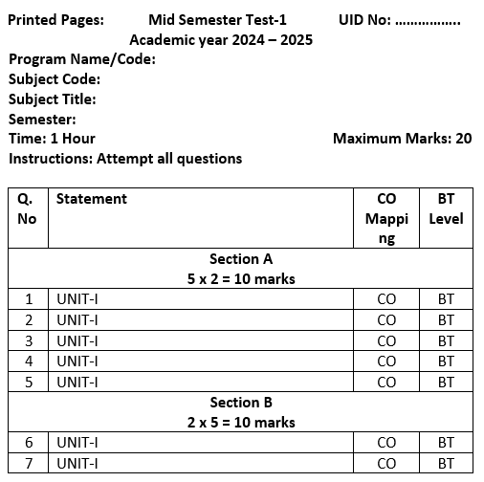
21
MST Model QP

Slide 23
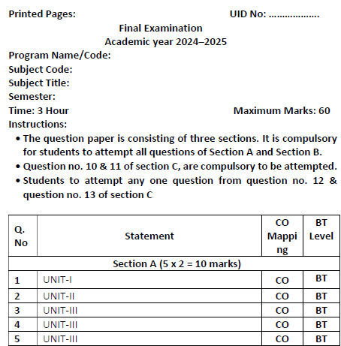
22
EST Model QP

Slide 24
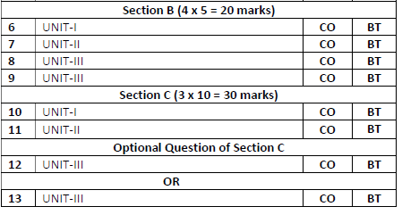
23
EST Model QP

Slide 25
24
Text and Reference Books
      T1 Numerical Methods for Scientist and Engineering Computation by M. K. Jain, S. R. K. Iyengar and R. K. Jain, New Age International Publisher, Ed. Fourth.
      T2 Introductory Methods of Numerical Analysis by S. S. Sastry.
      R1 Numerical Methods for Mathematics, Science and Engineering by Mathews, Prentice- Hall of India. Ed. Second.
      R2 A Friendly Introduction to Numerical Analysis, Brian Bradie, Pearson Education, India, 2007.

Slide 26
25
E-Learning links
https://onlinecourses.nptel.ac.in/noc26_ma62/preview
https://onlinecourses.nptel.ac.in/noc26_ma20/preview

Slide 27
26
Content Beyond Syllabus
Floating-Point Arithmetic and IEEE Standards
Condition Number and Stability Analysis
Hybrid Root-Finding Methods
Graphical Interpretation of Nonlinear Equations
Introduction to Numerical Software Tools

Slide 28
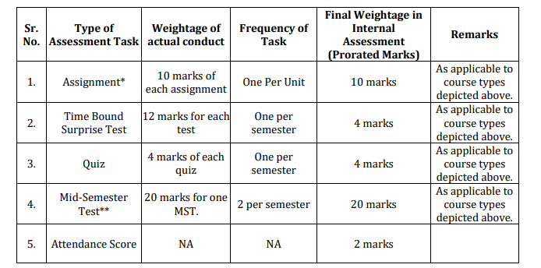
27
Assessment Model

Slide 29
28
Thank You

